Slide 1
Managing Cognitive Load in Multimedia Presentations: Reducing Extraneous Processing

Slide 2
Learning Objectives
Following review of this learning module, participants will be able to:
Describe the components of cognitive load
Explain five principles to reduce extraneous processing in multimedia presentations
Employ techniques to design slides which reduce cognitive load in multimedia presentations

Slide 3
Cognitive Load
Refers to the total amount of information a human is trying to process in the working memory at any one time
Working memory has a limited capacity

Slide 4
Cognitive Overload
If too much information is presented, the capacity of working memory is exceeded and some information is lost: this is referred to as cognitive overload
Cognitive overload hinders learning and leads to poor comprehension

Slide 5
Components of Cognitive Load
One goal of presentation design is to limit cognitive load. Understanding the components of cognitive capacity can help improve presentation design:
Components of Total Cognitive Capacity
Intrinsic Load
Germane Load
Extraneous Load

Slide 6
Components of Total Cognitive Capacity
Intrinsic Load
Germane Load
Extraneous Load
Intrinsic load – the inherent difficulty associated with a specific topic.
For example: Teaching basic addition (1 + 1 = 2) is intrinsically less difficult than teaching algebra (4x + 3 = 11).

Slide 7
Components of Total Cognitive Capacity
Intrinsic Load
Germane Load
Extraneous Load
Germane load – the organization and integration of information into schemas (or conceptual models).
Conceptualization leads to meaningful learning of complex topics.
Notes:
Do you have an example of this?

Slide 8
Components of Total Cognitive Capacity
Intrinsic Load
Germane Load
Extraneous Load
Extraneous load does not contribute to learning.
It is created by the manner in which information is presented.
Minimizing extraneous load through appropriate instructional design allows more working memory to be available for germane processing.
Notes:
Example of this maybe good too

Slide 9
5 Principles to Reduce Extraneous Load
Signaling
Coherence
Spatial contiguity
Temporal contiguity
Redundancy
A poorly designed slide will be presented for each principle.
Think about how the slide could be modified to reduce extraneous processing by implementing the principle.
A revised slide will then be presented.

Slide 10
Signaling Principle
People learn better when cues that highlight the organization of the essential material are added

Slide 11
Angiomyolipoma
Signaling
Benign neoplasms (no malignant potential)
There is a risk of hemorrhage
Hemorrhage risk depends on mass size
If > 4 cm may need excision or embolization
This slide describes the major potential complication of AMLs and its effect on management. There is unnecessary text, and there is no clear highlighting of the essential teaching points.

Slide 12
Signaling
Original
Revised

Slide 13
Angiomyolipoma
Signaling
Benign neoplasm
Risk of hemorrhage
> 4 cm: embolization or excision
In the revised slide design, the word count is reduced and yellow text is used to highlight essential material or “take home” points (signaling).

Slide 14
5 Principles to Reduce Extraneous Load
Signaling
Signaling
Coherence
Spatial contiguity
Temporal contiguity
Redundancy
This slide, used earlier in the presentation, highlights the order in which the material will be presented. Use of a organizational slide, such as this, is another application of the signaling principle.

Slide 15
Coherence Principle
People learn better when extraneous material is excluded rather than included (irrelevant words, pictures, symbols, sounds, etc.)

Slide 16
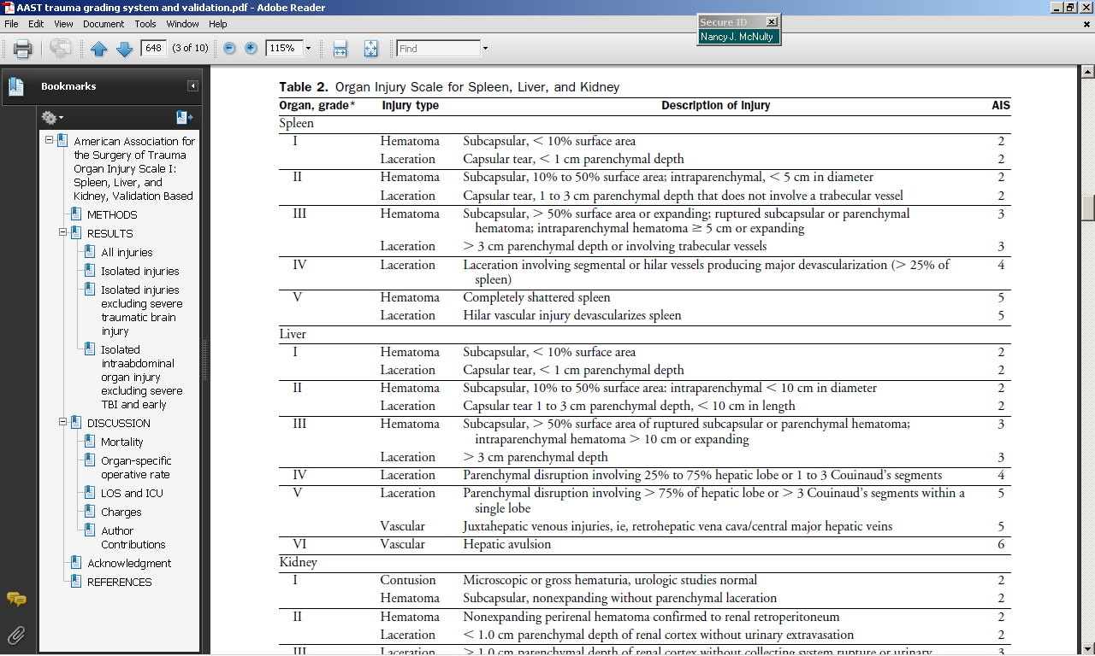
Coherence
For a discussion on grading of splenic injuries, the inclusion of liver and kidney grading is irrelevant and distracting.

Slide 17
Coherence
In this slide design, the chart is cropped to include only splenic injury grading.
For a discussion of grade 3 splenic injury, the appropriate section is highlighted (signaling).

Slide 18
Coherence
Original
Revised
An even more effective slide design is shown here. Elimination of the chart may further reduce cognitive load.

Slide 19
Grade 3 Splenic Injury
Coherence
Laceration: > 3 cm deep
Subcapsular hematoma: > 50% surface area
Intraparenchymal hematoma: >5 cm
This slide uses an image to illustrate the concept that is being taught. In general, it is more effective to teach using images and words rather than words alone.

Slide 20
Spatial Contiguity Principle
People learn better when corresponding words and pictures are presented near rather than far from each other on the screen

Slide 21
CT A/P w/con (coronal and axial)
Spatial contiguity
The words describing the imaging finding are placed far away from the finding itself.
Bulky, exophytic/endophytic submucosal GI mass

Slide 22
Spatial contiguity
Original
Revised

Slide 23
Spatial contiguity
Endophytic
Exophytic
Words presented near the imaging finding (spatial contiguity) increase the chance the learner will make mental connections between corresponding words and pictures. In order to make the salient finding more apparent, the image is cropped and enlarged.

Slide 24
Temporal Contiguity Principle
People learn better when corresponding words and pictures are presented simultaneously rather than successively

Slide 25
Temporal contiguity

Slide 26
Findings
Temporal contiguity
Homogenous echotexture of testicles
Engorgement and increased flow to the left epididymis
In this instructional design, images from the scrotal ultrasound (prior slide) are presented on a separate slide from the words that describe the sonographic images (current slide).

Slide 27
Temporal contiguity
Revised
Original

Slide 28
Temporal contiguity
Enlarged, hyperemic epididymis
Right
Left
In the revised slide design, the images and words are presented simultaneously (temporal contiguity). The words describing the findings are also positioned next to the finding (spatial contiguity).

Slide 29
Redundancy Principle
People learn better from graphics and narration than from graphics, narration, and printed text
In other words, you don’t have to put into text everything you will talk about on the slide

Slide 30
Three column concept is used to assess fracture stability
Redundancy
Anterior column
Anterior part of the vertebral bodies
Anterior part of the intervertebral discs
Anterior longitudinal ligament
Middle column
Posterior wall of the vertebral bodies
Posterior annulus of the intervertebral discs
Posterior longitudinal ligament
Posterior column
Posterior elements
Facet joints
Posterior ligament complex
In this slide design, text is provided for all narration.

Slide 31
Redundancy
Original
Revised

Slide 32
Stability: 3 Column Model
Redundancy
In this revised slide design, the text, which will be narrated, is eliminated (redundancy). This does not mean that there should be no text on slides. Instead, limit the text to the highlights.

Slide 33
Summary
Cognitive load refers to the total amount of information a human is trying to process in the working memory at any one time
Exceeding the capacity of working memory (termed cognitive overload) leads to poor comprehension
There are three components of cognitive load: intrinsic, germane, and extraneous
Extraneous load does not contribute to learning and can be modified by instructional design

Slide 34
5 Principles to Reduce Extraneous Load
Signaling: highlight essential words or images
Coherence: delete extraneous words or images
Spatial contiguity: put essential words next to corresponding images
Temporal contiguity: present corresponding text and images simultaneously
Redundancy: delete/reduce redundant text

Slide 35
References
Chandler, P.; Sweller, J. (1991). “Cognitive Load Theory and the Format of Instruction.” Cognition and Instruction. 8 (4): 293–332.
Mayer, R. (2009). Frontmatter. In Multimedia Learning (pp. I-Vi). Cambridge: Cambridge University Press.
Sweller, J.; Van Merriënboer, J. & Paas, F. (1998). "Cognitive architecture and instructional design". Educational Psychology Review. 10 (3): 251–296.

