Slide 1


Clinical Coaching
Faculty Development

Slide 2
By the end of this session, you will be able to:
Compare and contrast direct vs. indirect observation
Assess learner performance of a clinical skill
Provide effective feedback to a learner

Slide 3
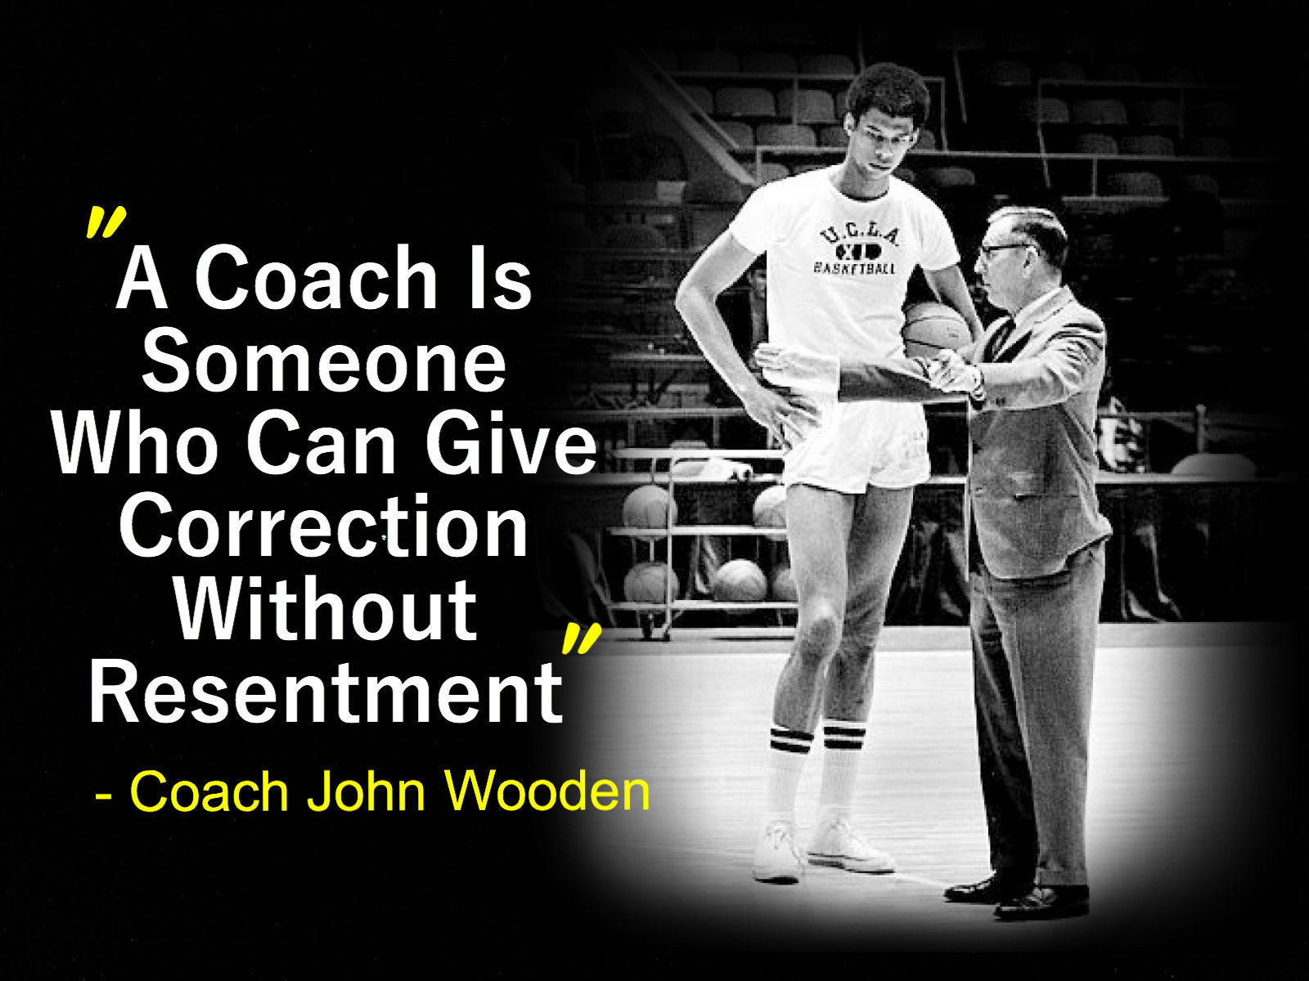

Slide 4

Learning objectives
Observe performance
Learning climate
Clinical credibility
Trust
Summative Feedback
Formative Feedback
Coach’s Assessment
The Clinical Coaching Cycle

Slide 5
Learning climate
Clinical credibility
Trust

Slide 6
Learning objectives
Learning climate
Clinical credibility
Trust

Slide 7
Learning objectives
Observe performance
Learning climate
Clinical credibility
Trust

Slide 8
Observe
What are you looking/listening for?
What are the common mis-steps made by novices?
  Are they making them?

Slide 9
Direct vs. Indirect Observation
Direct Observation
  Observes learner in patient-care environment
    History taking
    Physical exam
    Patient discussions
    Procedures
Indirect Observation
  Observes learner outside of patient-care environment
    Oral presentation*
    Note review

Slide 10
Keys to Direct Observation
Set expectations for the direct observations
Focus on the observation
Take notes

Slide 11
Learning objectives
Observe performance
Learning climate
Clinical credibility
Trust
Coach’s Assessment
Notes:
This is a period of time to think about what you saw
In real-time and immediately after the observation
This should tie back to the set expectations and should be tailored to the level of the learner
As a senior resident should be assessed very differently from a 3rd year medical student

Slide 12
Assessment
What do I reinforce? | What can be better?
Skills that they should keep doing | Skills with room for improvement

Slide 13
Learning objectives
Observe performance
Learning climate
Clinical credibility
Trust
Formative Feedback
Coach’s Assessment

Slide 14
Feedback
Panic Zone
Learning Zone
Comfort Zone

Slide 15
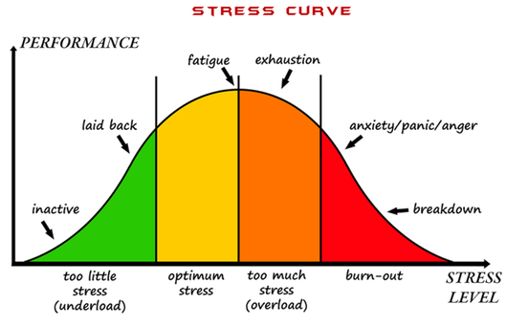

Slide 16
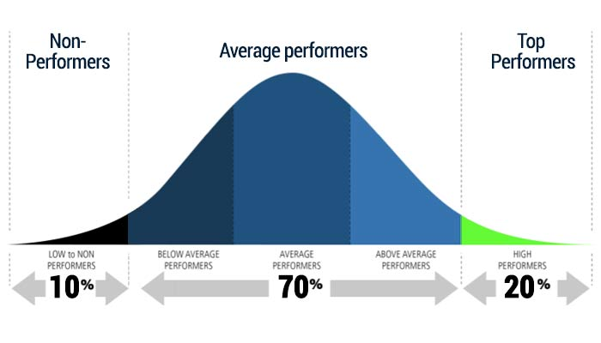
Struggling Learners
Average Learners
Excelling Learners
“I’m concerned…”
& refer
“You’re great!”
“Here’s how to take it to the next level…”
Nudge them up…

Slide 17
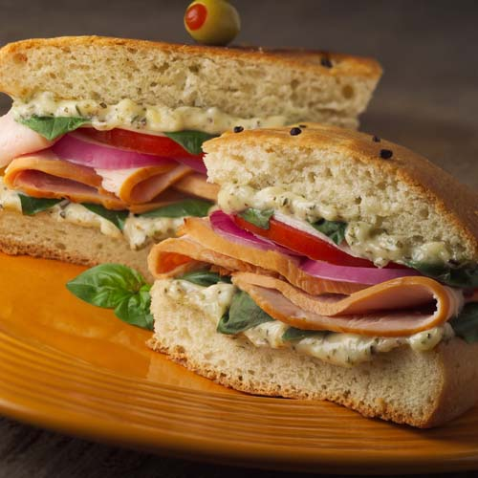
The Old Feedback Sandwich
Something good
Something bad
Something good

Slide 18
A New Feedback Sandwich
Ask
Tell
Ask

Slide 19
Ask | “How do you think you did _specific skilI__?” Establishes this as a conversation Assess learner insight
Tell
Ask

Slide 20
Ask | “How do you think you did _specific skilI__?” Establishes this as a conversation Assess learner insight
Tell | WHAT: Reinforce: “You did a great with _________.” Improve: “I noticed ___________” WHY: “It’s important to correct this because ___.”
Ask
Notes:
You did great with a assessing strength and sensation on your neurologic exam
I noticed that you had trouble assessing all of the reflexes
This is important to improve on since this can help assess many neurologic problems, including strokes

Slide 21
TELL: Formative Feedback
Future focus: Next time, try…
Swap it: Instead of _____, do ________.
Share the struggle: When I get stuck, I try…

Slide 22
Ask | “How do you think you did _specific skilI__?” Establishes this as a conversation Assess learner insight
Tell | WHAT: Reinforce: “You did a great with _________.” Improve: “I noticed ___________” WHY: “It’s important to correct this because ___.”
Ask | HOW: “Next time, how could you do it differently?” Then TELL your specific suggestions prn if needed

Slide 23
Challenges with Ask, Tell, Ask?

Slide 24

Growth occurs in layers
Goal
Gap
Reinforce

Slide 25
Learning objectives
Observe performance
Learning climate
Clinical credibility
Trust
Summative Feedback
Formative Feedback
Coach’s Assessment
The Clinical Coaching Cycle

Slide 26
Develop a prioritized differential diagnosis and select a working diagnosis following a patient encounter:
1
Unable to Perform
2
Requires Close Supervision
Requires proactive guidance and/or presence of a physician to complete
3
Requires Minimal Supervision
Successfully completes with feedback and/or clarification from a supervising physician
4
Due to inadequate skills, restricted to shadowing experiences
Performs Independently
Competent at an intern level, rarely needing feedback or clarification afterward

Slide 27
Gathering and organizing information in a hypothesis-driven way
Common to nearly all learners
  Seeing patients, chart review, looking at slides/films
Skill taught in a common way
Learners progress along developmental milestones

Slide 28
Our Case
Nick is a 3rd year medical student seeing an 18-year-old woman with abdominal pain.
I’ll present as the learner
  Infer his skills in gathering and organizing information.

Slide 29
Learner: Nick, M3, Presentation
Ms. Wall is an 18yo female and she came to the ED for abdominal pain. She says it’s worse in her lower abdomen, started 2 days ago, and is an 8/10. She has no sick contacts, no travel. Immunizations are uptodate. Nothing makes the pain better. She took some Tylenol but it didn’t help. It doesn’t seem to worsen with meals, even spicy or fatty meals. It gets worse with moving around. It’s a deep squeezing pain. She has nausea, no vomiting, no diarrhea.
Her past medical history is only anxiety on Zoloft.
Social history: She’s a freshman in college, lives in the dorm, so it’s good her immunizations are uptodate. No smoking, drugs, or alcohol
Family history: Grandma died of breast cancer; Both grandpas had heart attacks
Exam: Temp 99, HR 102, BP is fine.
Gen: She looks like she’s in pain, but I don’t think she is toxic.
Heart and lungs are normal. Abdomen is tender in her lower abdomen.
In summary, this is a young woman with acute lower abdominal pain. My differential diagnosis is appendicitis, PID, UTI, ovarian cancer, pregnancy, Crohn’s disease, kidney stones, pancreatitis.

Slide 30
Assessment
What do I reinforce? | What can be better?
Skills that they should keep doing | Skills with room for improvement
Notes:
-

Slide 31
Learner: Nick, M3, Presentation
Ms. Wall is an 18yo female and she came to the ED for abdominal pain. She says it’s worse in her lower abdomen, started 2 days ago, and is an 8/10. She has no sick contacts, no travel. Immunizations are uptodate. Nothing makes the pain better. She took some Tylenol but it didn’t help. It doesn’t seem to worsen with meals, even spicy or fatty meals. It gets worse with moving around. It’s a deep squeezing pain. She has nausea, no vomiting, no diarrhea.
Her past medical history is only anxiety on Zoloft.
Social history: She’s a freshman in college, lives in the dorm, so it’s good her immunizations are uptodate. No smoking, drugs, or alcohol
Family history: Grandma died of breast cancer; Both grandpas had heart attacks
Exam: Temp 99, HR 102, BP is fine.
Gen: She looks like she’s in pain, but I don’t think she is toxic.
Heart and lungs are normal. Abdomen is tender in her lower abdomen.
In summary, this is a young woman with acute lower abdominal pain. My differential diagnosis is appendicitis, PID, UTI, ovarian cancer, pregnancy, Crohn’s disease, kidney stones, pancreatitis.

Slide 32
Ask | “How do you think you did _________?
Tell | WHAT: Reinforce: “You did a great with _________.” Improve: “I noticed ___________” WHY: “It’s important to correct this because ______.”
Ask | HOW: “Next time, how could you do it differently?” TELL your specific suggestion: _________

Slide 33
Ask | “How do you think you did gathering the HPI information?”
Tell | WHAT: Reinforce: “You did a great with _________.” Improve: “I noticed ___________” WHY: “It’s important to correct this because ______.”
Ask | HOW: “Next time, how could you do it differently?” TELL your specific suggestion: _________

Slide 34
Ask | “How do you think you did gathering the HPI information?”
Tell | WHAT: Reinforce: “You did great gathering most of the modifying factors of the chief complaint.” Improve: “I agree that I did not know where the pain was after your presentation.” WHY: “It’s important to correct this because it can dramatically change our DDx.”
Ask | HOW: “Next time, how could you do it differently?” TELL your specific suggestion: _________

Slide 35
Ask | “How do you think you did gathering the HPI information?”
Tell | WHAT: Reinforce: “You did a great gathering most of the modifying factors of the chief complaint, abdominal pain.” Improve: “I agree that I did not have a good idea of exactly where the pain was after your presentation.” WHY: “It’s important to correct this because it can dramatically change our DDx.”
Ask | HOW: “Next time, how could you do it differently?” TELL: “Next time, review the HPI you’ve obtained with the patient to make sure you have specific details for all parts of the OLD-CARTs mnemonic for pain”

Slide 36
Patient Communication: Mary, PGY1
“Today we are going to de-escalate your antibiotics since your cultures are negative. This could still be Staph but we know it isn’t MRSA. Sound OK?”

Slide 37
Ask | “How do you think you did _________?
Tell | WHAT: Reinforce: “You did a great with _________.” Improve: “I noticed ___________” WHY: “It’s important to correct this because ______.”
Ask | HOW: “Next time, how could you do it differently?” TELL your specific suggestion: _________

Slide 38
Ask | “What do you think the patient took away from the conversation?”
Tell | WHAT: Reinforce: “It was good to alert to a medication change.” Improve: “I noticed you used some complex language…” WHY: “It’s important to correct this so our patients fully understand the plan”
Ask | “How would you translate it into something simpler next time?” Tell: “I struggled using medical jargon with patients too and now rehearse what I’m going to say in my mind first..here’s my version...”

Slide 39
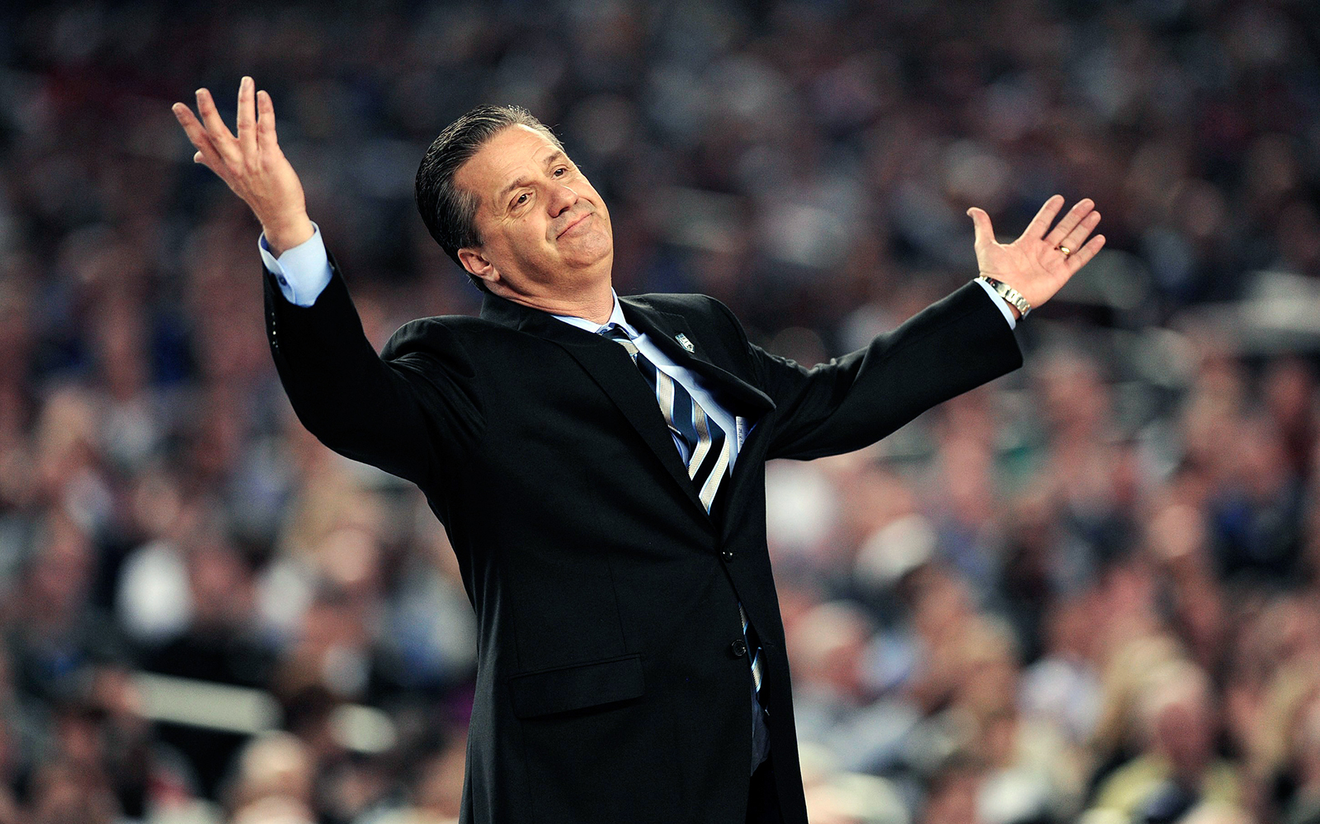


Slide 40


Slide 41
Practice the Skill
Will the learner get enough practice with this in usual setting?
Create practice opportunities
NO
YES
Selective assignments
Simulated practice
Prompt self-reflection, Give feedback, Maintain motivation

Slide 42
Practice the Skill
Enough practice in usual clinical setting?
  Yes: then, follow-up with continued coaching
  No: then, create practice opportunities
    Simulate a patient
    Create an assignment
Self reflection, feedback, motivation

Slide 43
Learning objectives
Observe performance
Learning climate
Clinical credibility
Trust
Summative Feedback
Formative Feedback
Coach’s Assessment
The Clinical Coaching Cycle

Slide 44

Commit
What coaching skill will you focus on next time you work with a learner?
What will you do differently?

Slide 45


