Slide 1
UK COM
Clinical Teaching
Faculty Development

Slide 2
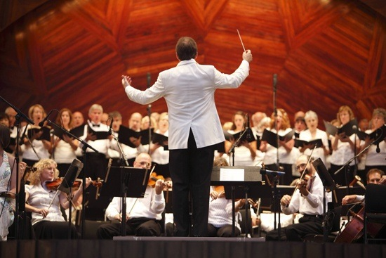
Conducting the Orchestra: Teaching a group of multi-level learners
Notes:
What are the similarities between this picture and what we do?
--playing all different instruments (working on different skills, playing different parts)
Who is the audience there to see?
--the musicians! They are the important ones. Not us…you only see our back.

Slide 3
Learning Objectives
Create an effective learning climate in a busy clinical environment
Formulate and communicate expectations for multiple levels of learners

Slide 4
Let’s look at this learning climate…
Just like a patient, we want to examine with intent.
Eager, engaged 3rd year student on the left.
Intern facing the computer trying to get work done.
Experienced senior resident directing team.
Observe. Take notes of what attending does and says that sets the learning climate…
http://www.youtube.com/watch?v=b7isn84Xouc

Slide 5
Learning Climate
Enthusiasm
Respect
Humility
Challenge and Support

Slide 6
Types of ineffective learning climates
Stressed watch-watcher
Drill sergeant
The “buddy”

Slide 7
Exhibit Enthusiasm
Introduce yourself
Describe your passion for learning and patient care
Display optimistic attitude toward the team & learning
Notes:
Voice, gestures, passion for teaching, learning and inquiry, humor….not always serious…or intently serious

Slide 8
Respect
Ask and use learner names
Consider individual differences that might affect learner’s participation
Safe place for all opinions and questions
Notes:
Hospitality – treats?
Give time for learning names, little of background, sharing, establish and reinforce
Stated in expectations
Respect opinions
Welcoming input
Making sure all voice heard—inviting
Dealing with small stuff—house keeping

Slide 9
Humility
Acknowledge your own limitations and errors
Encourage questions and independent thinking
Explicitly tell them when and how to ask for help
Notes:
In a seminal paper on clinical teaching (Irby 1979), the two traits rated lowest were being arrogant and dogmatic.

Slide 10
Challenge and Support
Provide support for uncertainties and problems
Challenge learners to advance their understanding and make new connections
Give reinforcing and constructive feedback
Notes:
Collect ideas from the group

Slide 11
Support and Challenge
 | Low Challenge | High Challenge
Low Support
High Support
Stasis
Fear
Growth and Development
Confirmation

Slide 12
Exhibit enthusiasm | Show respect
Model humility | Balance challenge and support

Slide 13
Practice: Enthusiasm, Respect, Humility
You are meeting the learners you’ll be working with for the next week.
What will you ASK? What will you TELL them?

Slide 14
Learning Climate
Enthusiasm
Respect
Humility
Challenge and Support

Slide 16
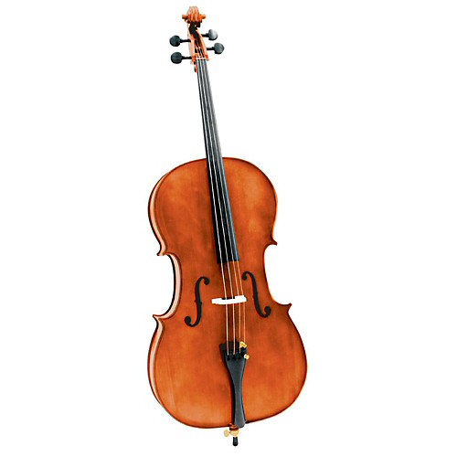
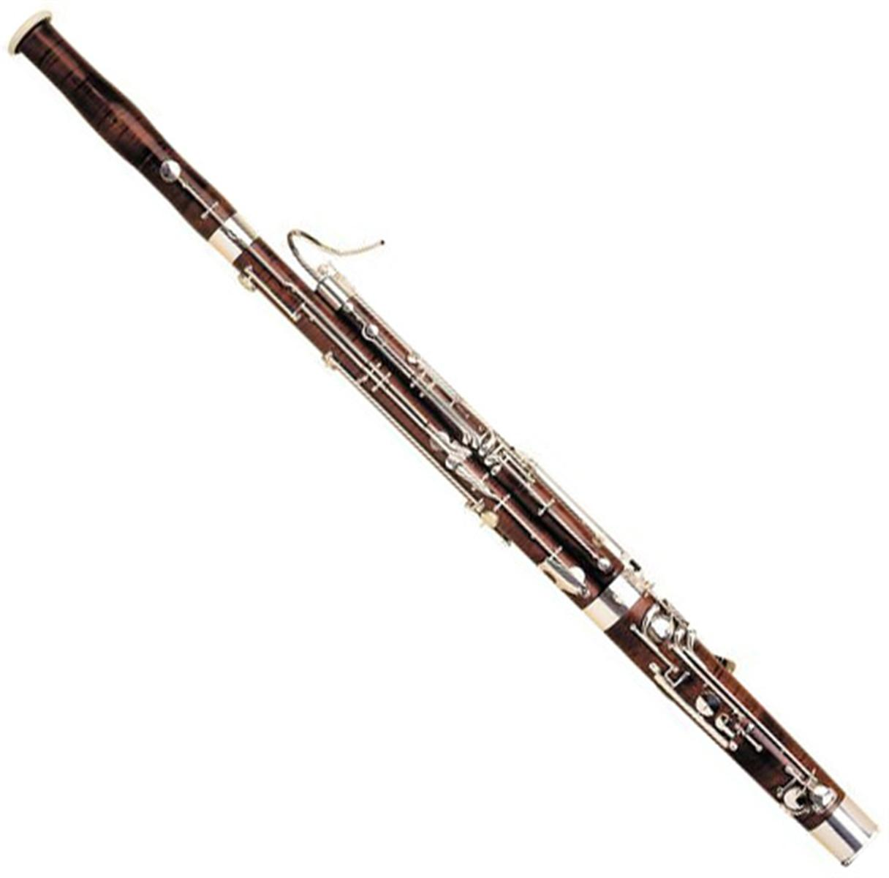
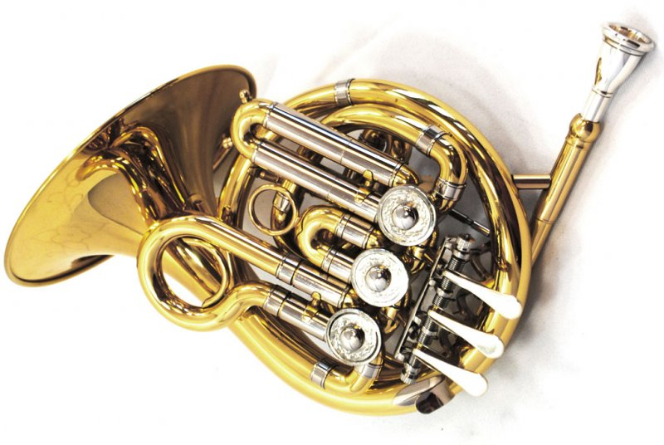
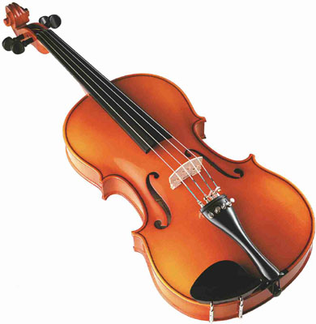
Setting and Communicating Expectations
An orchestra of multi-level learners…
With different roles and skills

Slide 17
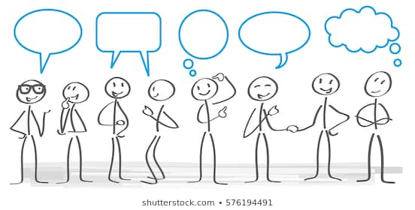
Multi-level teams
Other disciplines
Attending
Residents
Fellow
Students

Slide 18
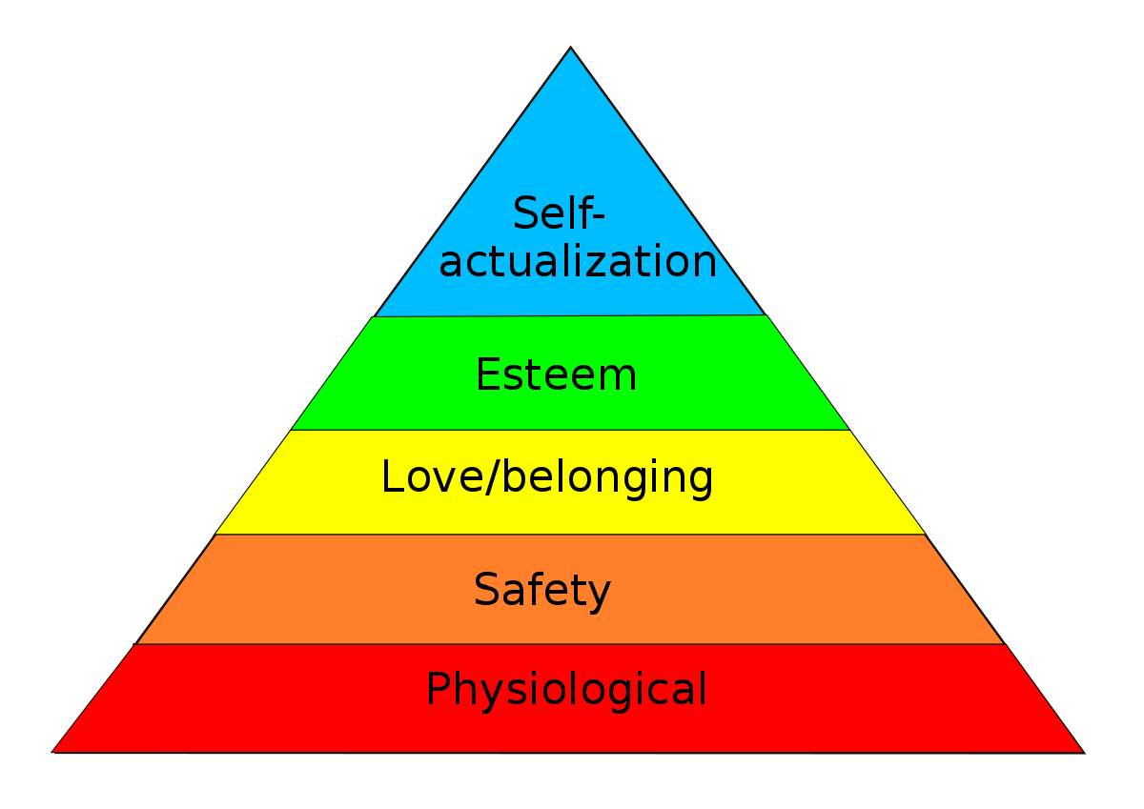
A tale of two pyramids

Slide 19
A tale of two pyramids
CEO
Manager
Staff

Slide 20
Setting expectations
Everyone needs to know:
Their job
What success looks like
What decisions they can make

Slide 21
The reality for our learners
Attending A
Attending B
Delegates daily management rounds to resident
Meet with team to discuss “big picture” plans
Wants to be informed of changes at end of day
Entrusts patient/family communication to learners
Highly engaged in bedside rounds
Performs key portions of the exam
Wants to approve any change in plan
Role models empathic patient-centered communication for learners

Slide 22
Roles in the clinical setting
Who? | Does what? | When/How? | Why?
Attending
Senior resident
Intern
Students M3 M4

Slide 23
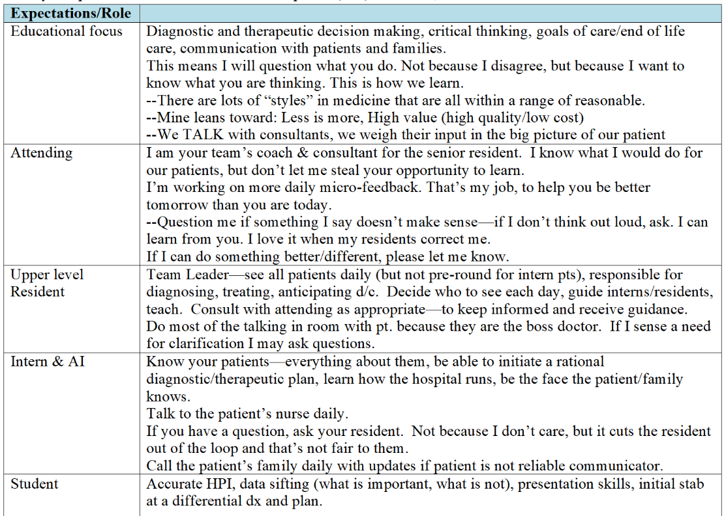

Slide 24
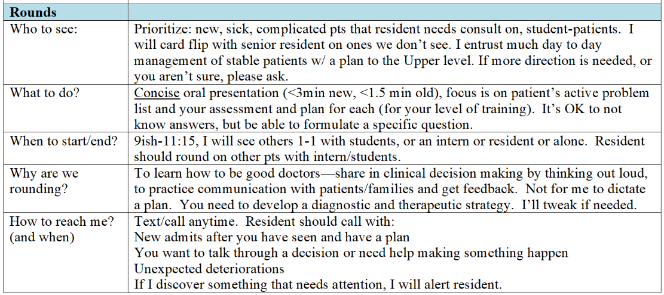

Slide 25
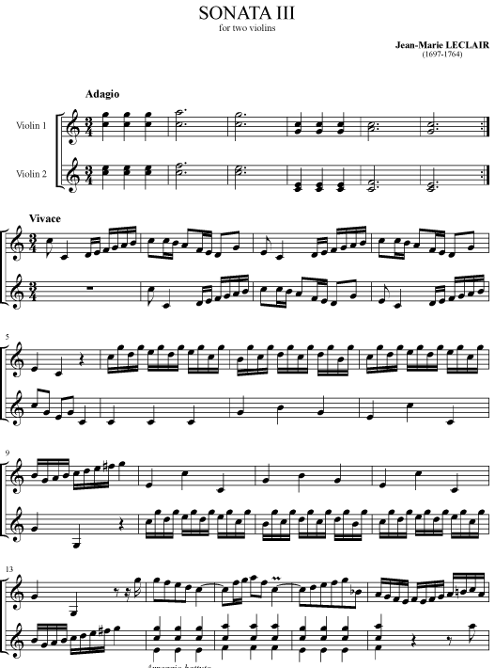
Role → Expectations → Assessment → Feedback

Slide 26
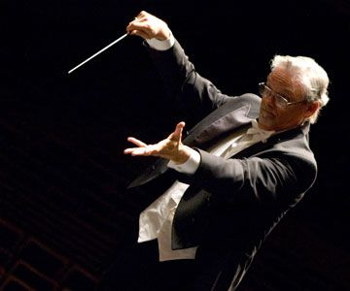
Maintain Harmony

Slide 27
Scenario:
The intern is a “gunner” & wants to impress everyone with her knowledge. She interrupts the students to correct them and asks them pointed factoids. When she proposes a plan that gets altered, she immediately retorts “Oh yeah, that’s what I meant to say…that’s what I was thinking too.”
The resident is often on his phone/laptop while care decisions are being made. He refers to the students collectively “Yo studs, come see this CT scan.” You have heard him bad mouth difficult patients, complain about nurses, and battle with the ED about new consults. He is not effectively supervising the intern/students and things are getting missed.

Slide 28
How are they experiencing this?
Attending
Resident
Intern
Student
How do you need to resolve?

Slide 29
Learning Objectives
Create an effective learning climate in a busy clinical environment
Formulate and communicate expectations for multiple levels of learners

