Slide 1
UK College of Medicine
Clinical Teaching Faculty Development
Individual Precepting

Slide 2
Learning Objectives
Practice framing and priming a learner for a patient encounter
Review precepting pitfalls and how to avoid them
Use effective questions to guide learner’s clinical reasoning

Slide 3
Who’s in the room?

Slide 4
What do you do?
Clinical Context
Sub
Specialized
General
Be aware of
Elicit history
Recognize
Diagnose
Manage

Slide 5
Who are you working with?
Level of Learner
Student
Intern
Resident/Fellow
Generate differential dx
Diagnose
Diagnose/Manage independently

Slide 6
Framing the Work
Focus
Time
Output
Clinic:
15 patients
3 new
12 follow-ups
Inpatient:
New consult/admit
9 AM vs. 4 PM

Slide 7
Framing the Work
Focus- focus of the encounter/ learning experience
Time- expected time
Why don’t you take about 10 minutes to do an HPI, a targeted exam, and be able to present to me.
Output- what you want the learner to generate in this session or time period

Slide 8
Framing the Work
Focus Time Output
Helpful to communicate at beginning of day or clinic session
Sets the expectations for the learner
May vary from day to day

Slide 9
Novice
Experienced
Focus of visit
Expected time
Output
Take a history
vs. full assessment
Output
What to go ahead & do?
What to ask about?

Slide 10
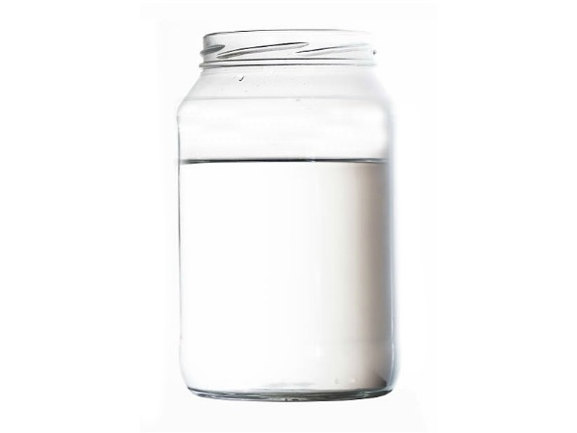
Prime the learner
The well of knowledge beneath the surface…

Slide 11
Prime the learner for a patient encounter
TELL
-Patient specific background information
-Important tasks to be performed
ASK
-To activate their knowledge

Slide 12
You and 3rd yr student seeing 58 y/o man with hematuria. Which of the following would be most appropriate to prime the student?
What is the pre-test probability this is a stone?
Make sure you ask about beet intake.
What are some causes of hematuria you can think of?
In this demographic, this is most likely bladder cancer.

Slide 13
Prime the Learner
TELL about patient and tasks
ASK questions to stimulate thinking
“Andy Jones is a 17 year old with poorly controlled Type 1 diabetes.”
“I’d like you to collect history of his recent diabetes management and do an appropriate focused exam.”
“Take ~10 minutes and be ready to present.”
“Before you go in…”

Slide 14
You are sending learner to see James, a previously healthy person with a chief complaint of cough for the past week.
You want to PRIME for a differential diagnosis.
What are a few things that can cause acute cough?
Tell me a couple things that could cause cough in this kiddo.
When you hear “cough for a week”, what causes come to mind?

Slide 15
You are sending learner to see James, a previously healthy person with a chief complaint of cough for the past week.
You want to PRIME for associated findings or key differentiators.
What are other important symptoms to ask about?
How can you differentiate asthma vs. pneumonia?

Slide 16
You are sending learner to see James, a previously healthy person with a chief complaint of cough for the past week.
You want to PRIME for assessing severity and management decisions
What red flags would you look for in him?
What’s going to make you WORRY about a cough?
How will you decide whether to get an x-ray on a guy with cough?

Slide 17
Do our pre-work
FRAME the work
PRIME for this patient
Focus
Time
Output
TELL
Specific background info
Tasks to be performed
ASK
To activate their knowledge

Slide 18
Precepting Pitfalls

Slide 19
Time to play…
Name that pitfall!

Slide 20
Precepting Pitfall #1
A student presents the story of a 16 YO girl with
5 days of sore throat and fever.
You ask the student: “Could this be mono?”
Closed question!

Slide 21
Avoiding the Closed Question
What’s on your differential for a 16 year old girl with sore throat and fever?
What are some causes of sore throat and fever in a young person?
I wonder what this could be? How interesting, she has had fever and sore throat for 5 days- what do you think this could be?

Slide 22
Precepting Pitfall #2
A student presents the story of a 16 YO girl with
5 days of sore throat and fever.
You ask: “What is most important to look for on exam?”

Slide 23
Avoiding the “Read My Mind” Question
What stood out to you about the exam?
How does your physical exam help you here?
How does the exam help you narrow your differential diagnosis?

Slide 24
Precepting Pitfall #3
Your intern presents a new consult and provides appropriate details suggestive of a new onset seizure—but doesn’t mention “seizure” is dx.
You say: “Great job! Sounds like a seizure. Let’s load him on Keppra.”
(Intern nervously writes that down…he thought this sounded like a stroke…)
Taking over!
How could we re-do?
Notes:
.

Slide 25
How to Avoid Taking Over
You did a great job describing this case, what are some diagnoses that could cause that?
Tell me what you think this could be.
What do you think this most likely is?
You’ve given me a thorough history and exam, so now it’s time to commit- what you do you could be going on here?

Slide 26
Precepting Pitfall #4
You ask an intern to see a 62-year-old woman who presents with a 6-month history of vertigo and tinnitus.
You spend 10 minutes describing the clinical features, complete diagnostic algorithm, and 1st-3rd line treatments for Meniere’s disease.
The monologue!
How could we re-do?

Slide 27
Avoiding the Monologue
You mention Meniere’s disease, great thought, but let’s take a step back and tell me some other causes of vertigo and tinnitus.
OR
Give 1-2 bullet points on Meniere’s disease and ask about some specifics to look for on history and exam.

Slide 28
Precepting Pitfall #5
Your student saw a patient taking amiodarone for atrial fibrillation.
You ask: “What is the impact of amiodarone on the peripheral activity of T4?”
When they say, “I don’t know”--remedy that with a cellular-level explanation...
How could we re-do?

Slide 29
Preventing Pitfalls in Precepting
Use questions to stimulate thinking not test recall of facts.
Use HOW and WHY >> WHICH and WHAT
Use openers like “Tell me…” and “I wonder…”
Know your learner
Novice
Pathophysiology/risk factors
Typical history and exam findings
How to diagnose and first-line tx
Advanced
Nuanced features
Atypical presentations
2nd/3rd line management

Slide 30
Summary
Frame the work the learner should do
Focus of visit, time spent, and output
Prime them for each patient encounter
TELL useful patient history & specific tasks
ASK questions to stimulate thinking ahead
Prevent common precepting pitfalls
Ask open ended questions (what, why, how)
Know what your learner needs to know…and what they don’t

